Slide 1
Sustainable Built Environment
Chapter 7: PASSIVE BUILDING TECHNOLOGIES

Slide 2
7.1 Introduction
7.2 Heat Preservation And Solar Passive Building Technologies
Contents
7.3 Thermal Insulation And Passive Cooling Technologies
7.4 Daylighting
7.5 Natural Ventilation
7.6 Passive Design Strategies
A Multidisciplinary Approach to Curriculum Development in Sustainable Built Environment

Slide 3


7.1 Introduction
The relationship between passive
technologies and climate
7.1.1
7.1.2
Passive design
A Multidisciplinary Approach to Curriculum Development in Sustainable Built Environment

Slide 4
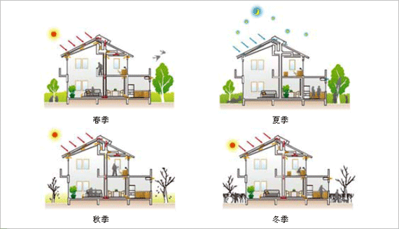
7.1.1 The relationship between passive technology and climate
Building
Generalized
building
systems
Energy input and output
Energy input and output
Energy
system
Outdoor
environ-ment
Energy input and output
A Multidisciplinary Approach to Curriculum Development in Sustainable Built Environment

Slide 5
Reduce building energy consumption
A
Reduce requirement
B
Utilize passive building technologies
C
Improve energy efficiency
A Multidisciplinary Approach to Curriculum Development in Sustainable Built Environment

Slide 6
The concept of passive design
Passive design
Local climate characteristics
Basic principles of building environment control
Building functions
Sunlight
Wind power
Temperature
Humidity
A Multidisciplinary Approach to Curriculum Development in Sustainable Built Environment

Slide 7
Numerous benefits of passive technology
Comfort
Investment
Energy
conservation
Benefits
Environment
protection
Low maintenance costs
Efficiency
A Multidisciplinary Approach to Curriculum Development in Sustainable Built Environment

Slide 8
7.2 Insulation
7.2.1
Building shape coefficient
7.2.2
Thermal insulation on external wall
7.2.3
Thermal insulation on roof
7.2.4
Thermal insulation on windows
7.2.5
Sun shading
A Multidisciplinary Approach to Curriculum Development in Sustainable Built Environment

Slide 9
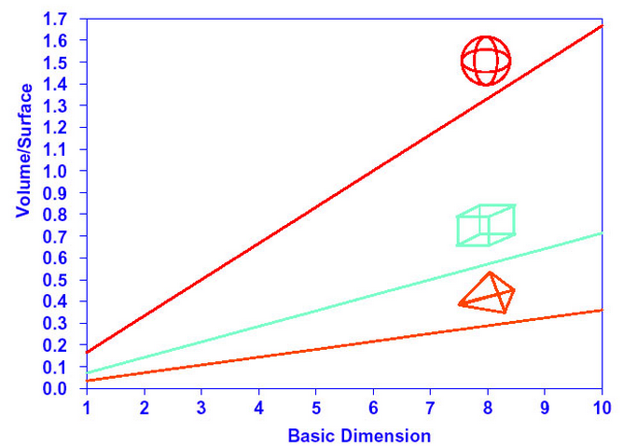
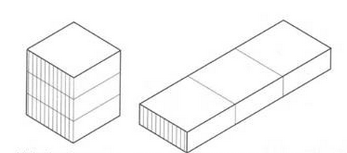
7.2.1 Building shape coefficient
Building shape coefficient is the external
surface area to volume (S/V) ratio of building.
S ----external surface area
V----volume
A Multidisciplinary Approach to Curriculum Development in Sustainable Built Environment

Slide 10
7.2.2 Thermal insulation on external wall
Exterior insulation
Interior insulation
Thermal insulation
Sandwich insulation
Self-insulation
A Multidisciplinary Approach to Curriculum Development in Sustainable Built Environment

Slide 11
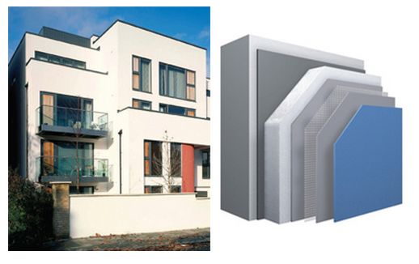
Exterior insulation
Advantages
Disadvantages
the risk of interstitial condensation is minimized
a significant impact on the external appearance
thermal protection
system must have high adhesion strength and stability
heat storage capacity
A Multidisciplinary Approach to Curriculum Development in Sustainable Built Environment

Slide 12
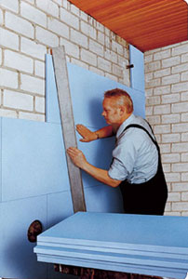
Interior insulation
Advantages
Disadvantages
convenient
to construct
condensation because of thermal bridges
less demanding
on walls
easy to crack
heat storage capacity
A Multidisciplinary Approach to Curriculum Development in Sustainable Built Environment

Slide 13
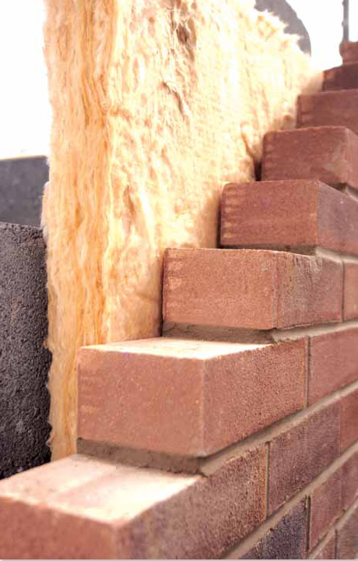
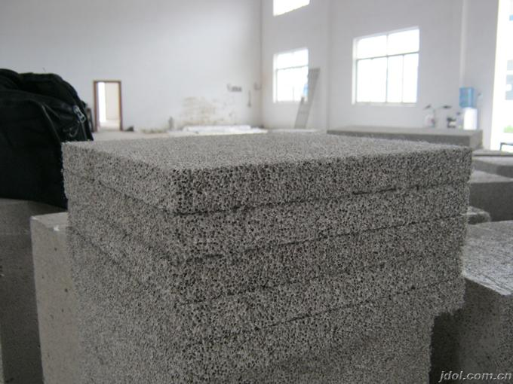
Sandwich wall insulation
Self-thermal insulation
A Multidisciplinary Approach to Curriculum Development in Sustainable Built Environment

Slide 14
Thermal insulation on roofs
Hot climate
Prevent excessive heat gains
Plastic sheeting
Synthetic
foam
batting
Fibrous
Concrete tiles
A Multidisciplinary Approach to Curriculum Development in Sustainable Built Environment

Slide 15
Insulating
materials
Roof pond
Ventilated
roof
Planted
roof
A Multidisciplinary Approach to Curriculum Development in Sustainable Built Environment

Slide 16
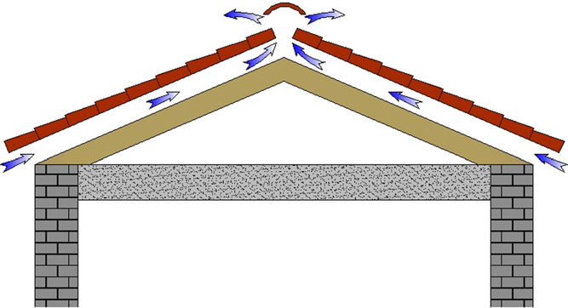
Ventilated roof
warm air
Natural convection
A Multidisciplinary Approach to Curriculum Development in Sustainable Built Environment

Slide 17
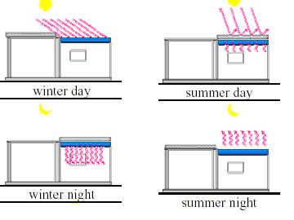
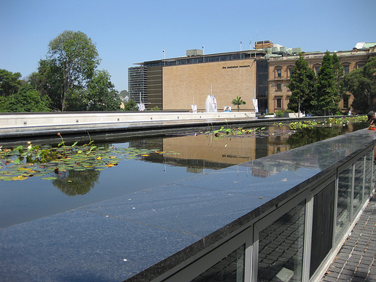
Roof pond
A Multidisciplinary Approach to Curriculum Development in Sustainable Built Environment

Slide 18
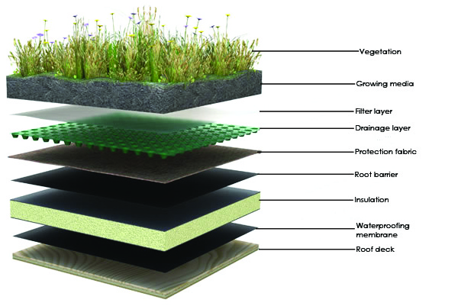
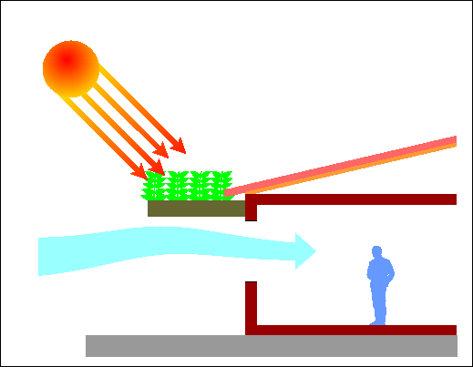
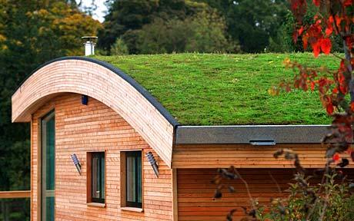
Planted roof
A Multidisciplinary Approach to Curriculum Development in Sustainable Built Environment

Slide 19
Thermal insulation on windows
Air infiltration
Outdoor
Doors
and
windows
Indoor
Heat transfer
A Multidisciplinary Approach to Curriculum Development in Sustainable Built Environment

Slide 20
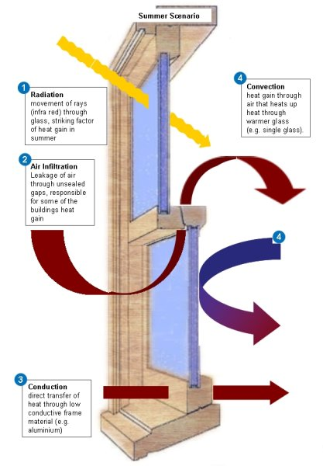
Insulated glazing
A Multidisciplinary Approach to Curriculum Development in Sustainable Built Environment

Slide 21
Change glass structure
Design of window frame
Ways
Design proper window frame ratio
Glass coating
Improve air tightness
A Multidisciplinary Approach to Curriculum Development in Sustainable Built Environment

Slide 22
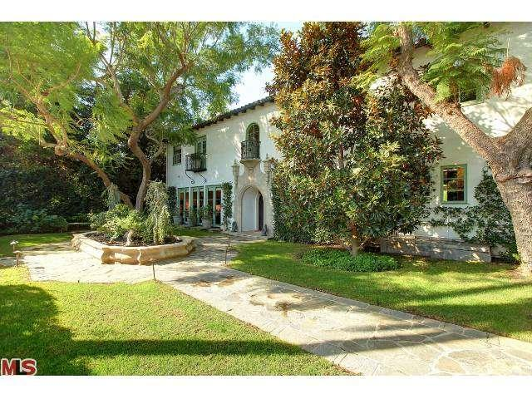
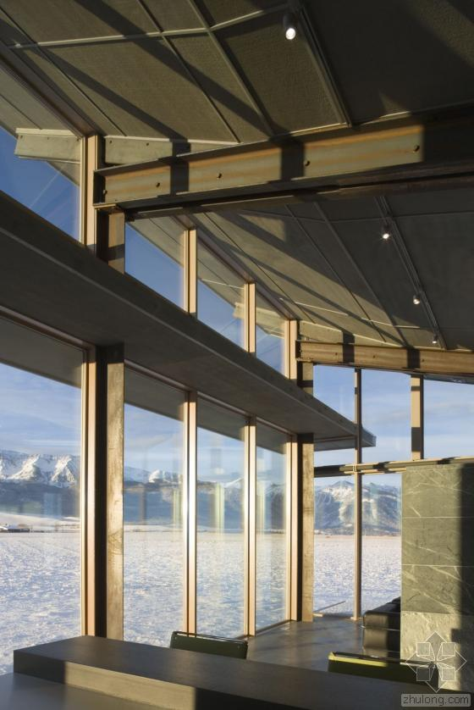
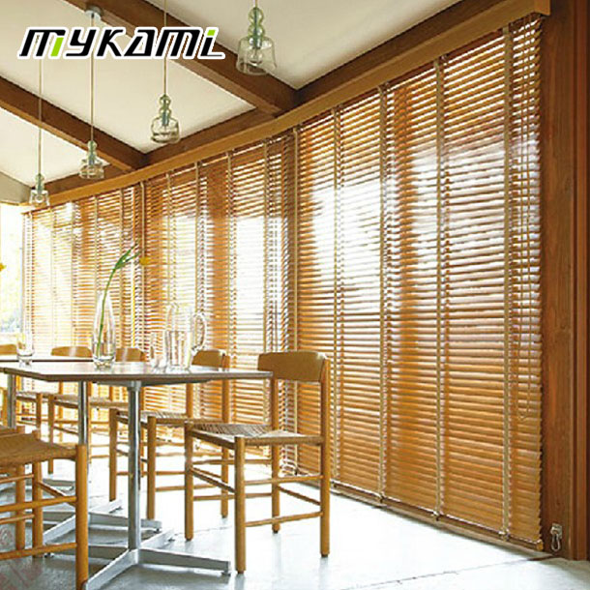
总结
Shading
Type A:Landscape features
Type B: Retractable
Type C: Fixed redistribution devices
Type D: Selective high performance glazing.
A Multidisciplinary Approach to Curriculum Development in Sustainable Built Environment

Slide 23
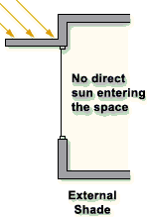
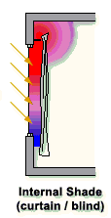
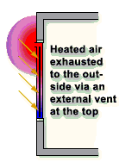
The most efficient
Difficult to control from the inside
External shading
Internal shading
Mid-pane
Much cheaper
Easy to control
Less efficient
Efficient
Easy to control
A Multidisciplinary Approach to Curriculum Development in Sustainable Built Environment

Slide 24
7.3 Passive solar and cooling technology
Passive solar technology
①Direct solar gain
②Trombe wall
③Sun space
A
Passive cooling technology
① Preventative techniques
② Modulation and heat dissipation techniques
B
A Multidisciplinary Approach to Curriculum Development in Sustainable Built Environment

Slide 25



Passive solar technology
Direct solar gain
Trombe wall
Sunlight
Heat storage
Interior space
Sunspace
A Multidisciplinary Approach to Curriculum Development in Sustainable Built Environment

Slide 26
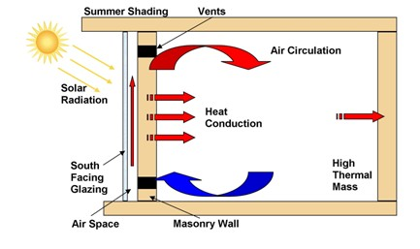
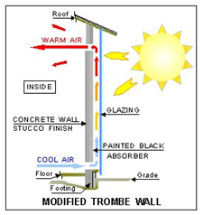
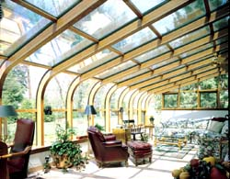
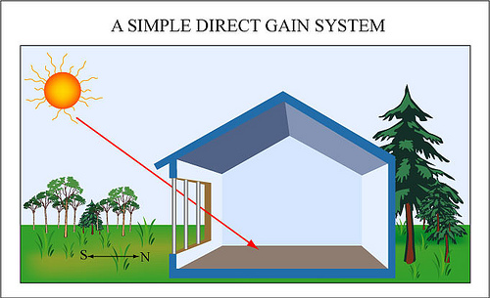
7.3.1 Passive solar technology
Direct solar gain
Trombe wall
Sunspace
Design principles:
①Well insulation
②Orientation
③Thermal mass
④Close to storage units
Design principles:
①Dark colour
②Angle of radiation
③Reflective surface
④Heat capacity
⑤Surface conductivity
Forms:
①Direct solar gain
②Trombe wall
③Roof pond
④Attached sunspace
A Multidisciplinary Approach to Curriculum Development in Sustainable Built Environment

Slide 27
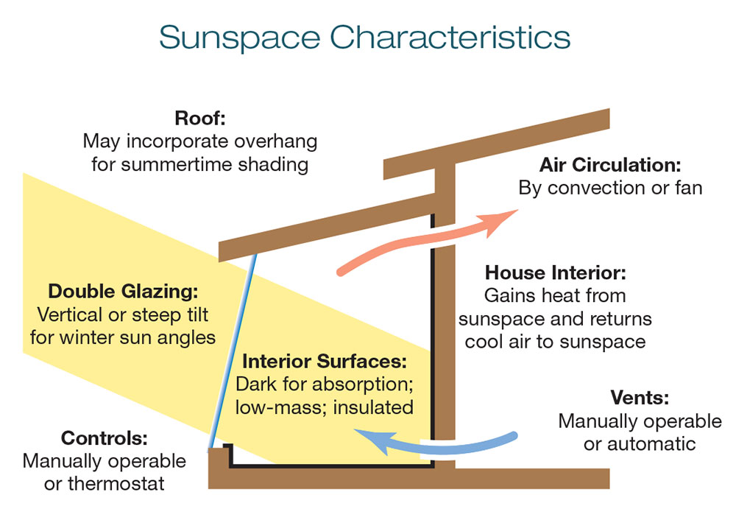
A Multidisciplinary Approach to Curriculum Development in Sustainable Built Environment

Slide 28
on-site energy
7.3.2 Passive cooling technology
Hybrid cooling
般若黑洞
般若黑洞 & 创作
Modulation
and
heat dissipation
Architectural design
Simple mechanical system
Preventative
techniques
Passive cooling technology
A Multidisciplinary Approach to Curriculum Development in Sustainable Built Environment

Slide 29
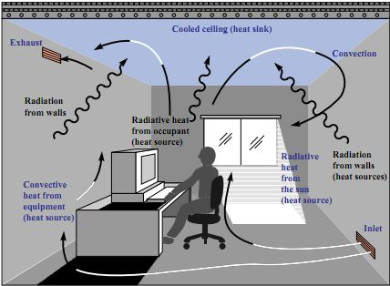
Modulation and heat dissipation techniques
Ventilation
Ventilation as a natural cooling strategy uses the physical properties of air to remove heat or provide cooling to occupants.
Radiant
Cooling
Direct Radiant Cooling
Indirect Radiant cooling
Evaporative Cooling
The design relies on the evaporative process of water to cool the incoming air while simultaneously increasing the relative humidity.
A Multidisciplinary Approach to Curriculum Development in Sustainable Built Environment

Slide 30
7.4 Daylighting
7.4.1
Overview
7.4.2
Design methods and measures
A Multidisciplinary Approach to Curriculum Development in Sustainable Built Environment

Slide 31
7.4.1 Overview
7.4.1.1 What is“Daylighting”
7.4.1.2 Significance of Daylighting
A Multidisciplinary Approach to Curriculum Development in Sustainable Built Environment

Slide 32

7.4.1 the concept of daylighting
the practice of placing windows or other openings and reflective surfaces so that during the day natural light provides effective internal lighting.
concept
Daylighting
Characte-ristic
fully utilize natural light to illuminate in the architectural design .
A Multidisciplinary Approach to Curriculum Development in Sustainable Built Environment

Slide 33
7.4.1.2 Significance of Daylighting
A
Improve work efficiency
B
More comfort, more healthy
C
Reduce artificial lighting load
D
Reduce the cooling load
A Multidisciplinary Approach to Curriculum Development in Sustainable Built Environment

Slide 34
7.4.2 Design methods and measures
7.4.2.1
7.4.2.2
7.4.2.3
Basic strategy of determine opening windows
Identify the performance target
Determine the basic strategy
7.4.2.6
7.4.2.5
7.4.2.4
Integrate with
the artificial
lighting
Strategy of open skylight
Select glazing materials
A Multidisciplinary Approach to Curriculum Development in Sustainable Built Environment

Slide 35
7.4.2.1 Identify the performance target
daylight
standard
Save lighting energy costs & improve the optical quality
Optical
quality
A Multidisciplinary Approach to Curriculum Development in Sustainable Built Environment

Slide 36
(1)Daylight factor
The Daylighting of a room is characterized by daylight factor as follows:
DF=(Ei/Eo)x100%
where Ei is illuminance at a given plane due to light received from the sky of particular illuminance, Eo is illuminance of same component of light on the horizontal plane due to unobstructed hemisphere of the sky
A Multidisciplinary Approach to Curriculum Development in Sustainable Built Environment

Slide 37
(2)Improve optical quality
Reducing the illumination gradient
The more light bring into
the interior deep place
A
Eliminate excessive brightness ratio
High brightness ratio will
make people uncomfortable
B
Avoid glare of direct illuminate
Avert glare In shady places
where not illuminated
C
A Multidisciplinary Approach to Curriculum Development in Sustainable Built Environment

Slide 38



7.4.2.2 Determine the basic strategy
Site analysis
Spatial layout
a well-designed
daylighting
system
Daylighting direction
A Multidisciplinary Approach to Curriculum Development in Sustainable Built Environment

Slide 39


(1)Site analysis
Establish design guidelines & When and where needed sunlight.
1
To determine entry mode of natural light
Which activities require direct natural light.
2
Assessment of existing venues, to determine obtain sunlight design methods.
3
A Multidisciplinary Approach to Curriculum Development in Sustainable Built Environment

Slide 40
(2)Spatial layout
Therefore, it should decrease the depth of buildings. In case of one side depth greater than 10m, set patio as far as possible.
Regions Completely unable to use of natural light
Parts of the regions can be illuminated with natural light
Regions can be fully illuminated with natural light
Depth <5m
5m≦Depth≦10m
Depth>10m
A Multidisciplinary Approach to Curriculum Development in Sustainable Built Environment

Slide 41



(3)Daylighting direction
East side
North side
South side
The best direction
The light from this direction is relatively stable
Higher quality of light
Not encounter the problem of glare
A better direction
Sunshine obtained maximum
Greenhouse effect generated from south window which meet some of the demand for heating
West side
East and West are the most unfavorable direction whick can increase cooling load in summer.
A Multidisciplinary Approach to Curriculum Development in Sustainable Built Environment

Slide 42
7.4.2.3 Basic strategy of determine opening windows
Increase the height
of windows
Natural light filter
Open windows on
both sides of walls
Design
Principle
Avoid windows
are illuminated
By bright light
Open window near the
other side of the wall
Applying moveable
shading devices
A Multidisciplinary Approach to Curriculum Development in Sustainable Built Environment

Slide 43
7.4.2.4 Select glazing materials
Transparent glass
Heat-absorbing
glass
Has a high transmittance , light can be obtained maximum
Absorbing infrared rays radiation, prevent
thermal radiation through glass
Glass Materials
Heat-reflecting
glass
Spectral selective glass
High thermal reflect capability, effectively prevent solar radiation
High visible light transmittance,
low ultraviolet transmittance, filter harmful rays of sunlight
A Multidisciplinary Approach to Curriculum Development in Sustainable Built Environment

Slide 44
Glass materials selection principles:
Transparent glass
Using double-deck transparent glass & Applying
in high daylight demand buildings.
Heat-reflecting glass
Applying in the buildings of glare problems & the regions
where aviod sun radiation & the large area of skylight.
Heat-absorbing and Spectral selective glass
More flexible and can be better balance
between daylighting and heat gain control.
A Multidisciplinary Approach to Curriculum Development in Sustainable Built Environment

Slide 45
7.4.2.5 Strategy of open skylight
Using outdoor sunshade balance summer/winter light
Skylight close to the wall
Skylights maintain
interval
Using larger gradient skylight balance summer/winter light
CommonStrategy
Indoor reflector to diffuse sunlight
Installed in a high place
A Multidisciplinary Approach to Curriculum Development in Sustainable Built Environment

Slide 46

7.4.2.6 Integrate with the artificial lighting
Automatic control system
Text in here
Natural
lighting
Artificial lighting
Text in here
Reasonable lamp mounting position
A Multidisciplinary Approach to Curriculum Development in Sustainable Built Environment

Slide 47
sunshade
B
heat preservation and heat insulation
solar heating
A
C
PASSIVE
BUILDING
E
D
natural ventilation
evaporative cooling
A Multidisciplinary Approach to Curriculum Development in Sustainable Built Environment

Slide 48
7.5 Natural Ventilation
Summary
7.5.1
Summary
7.5.1
7.5.1
Summary
Fundamental principles
7.5.2
Fundamental principles
7.5.2
4.2
.2
7.5.3
Design methods and measures
A Multidisciplinary Approach to Curriculum Development in Sustainable Built Environment

Slide 49
7.5.1 Summary
Definition and significance
Natural
Ventilation
Classification
Advantages
A Multidisciplinary Approach to Curriculum Development in Sustainable Built Environment

Slide 50

7.5.1.1 Definition and significance of natural ventilation
Natuaral Ventilation
Definition
Significance
A kind of passive ventilation mode driven solely by the natural force, which do not need to consume energy
Decrease the energy Consumption
Remove wet and dirty air and
provide fresh and clean natural air
A Multidisciplinary Approach to Curriculum Development in Sustainable Built Environment

Slide 51
7.5.1.2 Advantages of natural ventilation
Save investment and don't consume energy
Applicable for a wide area and long time
Advantages
Improve the IAQ
Promote the evaporation of sweat
Control indoor environment
A Multidisciplinary Approach to Curriculum Development in Sustainable Built Environment

Slide 52
7.5.1.3 classification of natural ventilation
Airflow acts on the building
generate pressure difference
the air flows into building
Wind force
Natural
ventilation
Thermal
force
Hot air ascends and the cool air
descends (Chimney effect)
Wind &
thermal force
The natural ventilation combined wind and thermal force
Mechanical
auxiliary
Integrate mechanical and natural ventilation reasonable control
A Multidisciplinary Approach to Curriculum Development in Sustainable Built Environment

Slide 53
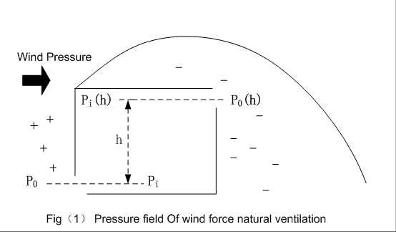
7.5.2 Fundamental principles:wind force ventilation
Air flow caused by wind force:
Total pressure:
A Multidisciplinary Approach to Curriculum Development in Sustainable Built Environment

Slide 54
7.5.2 Fundamental principles:thermal force ventilation
Indoor and outdoor
temperature difference
Sb title
Thermal force ventilation
Air density difference
A driving force
make airlow
A Multidisciplinary Approach to Curriculum Development in Sustainable Built Environment

Slide 55
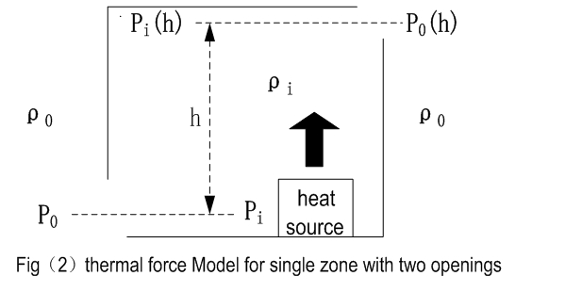
7.5.2 Fundamental principles:thermal force ventilation
Air flow caused by wind force:
Two main factors
Height difference
Temperature difference
A Multidisciplinary Approach to Curriculum Development in Sustainable Built Environment

Slide 56
7.5.3 Design methods and measures of natural ventilation
Step1
Step2
Step3
Prediction and optimization of building micro environment
Design and use
of wind and thermal force
Climate potential analysis
Step6
Step5
Step4
Program
evaluation
Control strategy
Equipment selection
A Multidisciplinary Approach to Curriculum Development in Sustainable Built Environment

Slide 57
Step1—Climate potential analysis
Natural ventilation potential is the potential to achieve the demand of IAQ and thermal comfort only relying on the natural ventilation.
Collect meteorological parameter of target area.
Make a climatic potential analysis.
Develop the corresponding climate strategies.
A Multidisciplinary Approach to Curriculum Development in Sustainable Built Environment

Slide 58
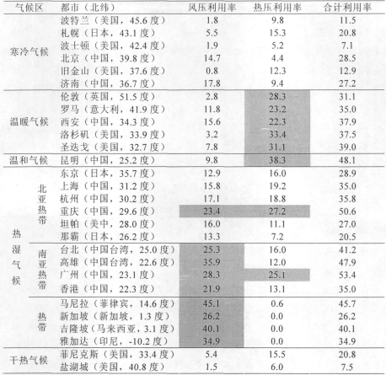
Step1—Climate potential analysis
Tab1. ventilation efficiency in
different climate zones
the grey areas represent that the ventilation efficiency is above 20%
A Multidisciplinary Approach to Curriculum Development in Sustainable Built Environment

Slide 59
Step2—Prediction and optimization of micro environment
Building orientation, spacing and layout
Design is based on the local dominant wind direction.
A
Arrangement of vegetation and water
Vegetation and water is beneficial to producing more comfortable airflow.
B
Wind environmental prediction
Use wind tunnel simulation and empirical formula to prediction
C
A Multidisciplinary Approach to Curriculum Development in Sustainable Built Environment

Slide 60
Step3—Design and use of wind and thermal force
Wind pressure ventilation design
1
When wind speed is high, adjust the opening to reduce ventilation quantity.
When wind speed is low, reduce the resistance of the route of building
interior airflow.
The most direct way to
shorten the route of airflow
is cross ventilation.
A Multidisciplinary Approach to Curriculum Development in Sustainable Built Environment

Slide 61
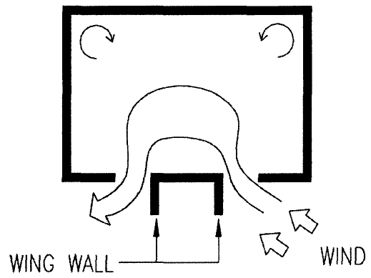
Thermal force ventilation design
1
wing wall and airflow
Man-made air pressure difference.
When the wind incidence angle is 45°, effect of ventilation is the best.
A Multidisciplinary Approach to Curriculum Development in Sustainable Built Environment

Slide 62
Thermal force ventilation design
2
Solar enhanced natural ventilation
Use the sunlight to heat the indoor air
Double glass curtain wall
Roof solar chimney
Based on the thermal force principle
Courtyard thermal force ventilation
Large height difference is conducive to improve the ventilation efficiency
Thermal force ventilation tower
Enclosed thermal buoyancy ventilation
Combine cloister and ventilation tower
A Multidisciplinary Approach to Curriculum Development in Sustainable Built Environment

Slide 63
Thermal force ventilation design
2
Solar enhanced natural ventilation
Double glass curtain wall
Roof solar chimney
A Multidisciplinary Approach to Curriculum Development in Sustainable Built Environment

Slide 64
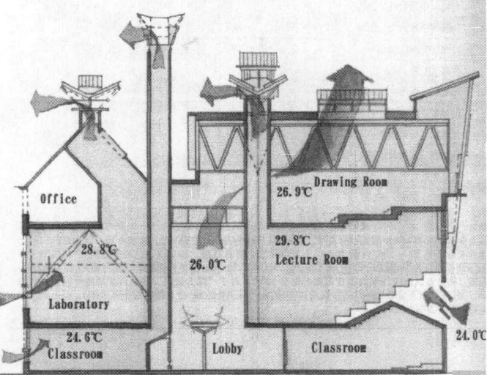
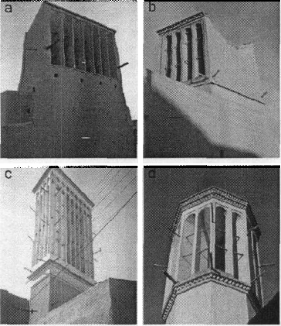
Thermal force ventilation design
2
Wind catch tower in Iran
Courtyard thermal force ventilation
A Multidisciplinary Approach to Curriculum Development in Sustainable Built Environment

Slide 65
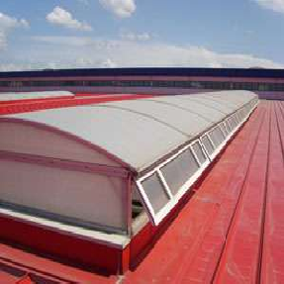
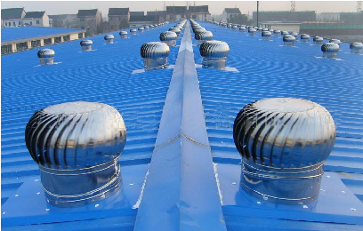
Step4—Equipment selection
Thermal ventilation equipment is an apparatus for use of pressure partly.
wind-proofed skylight
Guarantee the stable ventilation.
Set windshield on the dormer .
Turbine ventilator
Rotate the internal turbine.
Draw the indoor air out.
A Multidisciplinary Approach to Curriculum Development in Sustainable Built Environment

Slide 66
Step5—Control strategy of natural ventilation
Cold region
Insulation and air tightness.
A closed ventilation culture.
Mainly use thermal force ventilation.
Temperate regions
Dry-hot region
Suitable for thermal force ventilation.
Auxiliary of chimney effect.
Markedly different ventilation
mode in different seasons
Make full use of the chimney effect.
Increase the water design.
Make full use of natural night
ventilation.
Control Strategy
Hot-humid region
Dehumidification and cooling.
An open ventilation culture.
Mainly use wind pressure ventilation.
A Multidisciplinary Approach to Curriculum Development in Sustainable Built Environment

Slide 67
Step6—Program Evaluation
Uncertainty of thermal comfort
A
Points should be taken into consideration
Uncertainty of air quality
B
Uncertainty of ventilation volume
C
Not suitable for the building of which the ventilation requirements is large.
D
Not suitable for the place that have a high requirements for prevention of fire and smoke
E
A Multidisciplinary Approach to Curriculum Development in Sustainable Built Environment

Slide 68
7.6 Passive design strategies
7.6.1
Warm wet climate
7.6.2
Dry hot climate
7.6.3
Cold climate
7.4.2
7.6.4
Temperate climate
A Multidisciplinary Approach to Curriculum Development in Sustainable Built Environment

Slide 69
7.6.1 Warm wet climate
7.6.1.1 The location and characteristics of the climate types
7.6.1.2 Warm wet climate challenges and problems
7.6.1.3 Basic implementation strategies
7.6.1.4 The detailed design and construction strategies
A Multidisciplinary Approach to Curriculum Development in Sustainable Built Environment

Slide 70
7.6.1.1 The location and characteristics of the climate types
7.6.1.1.1 Moist tropical climate
7.6.1.1.2 Tropical wet and dry climate
7.6.1.1.3 Moist subtropical climate
A Multidisciplinary Approach to Curriculum Development in Sustainable Built Environment

Slide 71
7.6.1.1.1 Moist tropical climate
location
It is located in the coast ,or extends from the coast to inland.
Moist tropical climate
Characte-ristic
Hot and rainy, rich in the rain
A Multidisciplinary Approach to Curriculum Development in Sustainable Built Environment

Slide 72
7.6.1.1.2 Tropical wet and dry climate
location
It often appears in the high altitude land.
Tropical wet and dry climate
Characte-ristic
Wet and dry conditions
A Multidisciplinary Approach to Curriculum Development in Sustainable Built Environment

Slide 73
7.6.1.1.3 Moist subtropical climate
location
The area is basiclly located in the coast,and extends 1000—1250km to inland.
Moist subtropical climate
Characte-ristic
Hot and rainy, rich in the rain
A Multidisciplinary Approach to Curriculum Development in Sustainable Built Environment

Slide 74
7.6.1.2 Warm wet climate challenges and problems
The air temperature and relative humidity is much higher than the thermal comfort range.
1
Problems caused by warm wet climate will affect the thermal comfort.
2
The building form in the warm wet climate makes lifestyle need adjustment.
3
A Multidisciplinary Approach to Curriculum Development in Sustainable Built Environment

Slide 75
7.6.1.3 Basic implementation strategies
Indoor natural
ventilation
Sun-shade
Strategi es
Light building
envelope
Building
waterproofing
A Multidisciplinary Approach to Curriculum Development in Sustainable Built Environment

Slide 76
7.6.2 Dry hot climate
7.6.1.1 The location and characteristics of the climate types
7.6.1.2 Dry hot climate challenges and problems
7.6.1.3 Basic implementation strategies
7.6.1.4 The detailed design and construction strategies
A Multidisciplinary Approach to Curriculum Development in Sustainable Built Environment

Slide 77
7.6.2.1 The location and characteristics of the climate types
7.6.2.1.1 Dry heat climate
7.6.2.1.2 Subtropical summer drought climate
A Multidisciplinary Approach to Curriculum Development in Sustainable Built Environment

Slide 78
7.6.2.1.1 Dry heat climate
location
It is located between 20 to 30 degrees from the equator.
Dry heat climate
Characte-ristic
Rainfall is less
A Multidisciplinary Approach to Curriculum Development in Sustainable Built Environment

Slide 79
7.6.2.1.2 Subtropical summer drought climate
location
It is located between 32 to 36 degrees from the equator.
Subtropical summer drought climate
Characte-ristic
In summer dry and hot , in winter cold and wet
A Multidisciplinary Approach to Curriculum Development in Sustainable Built Environment

Slide 80
7.6.2.2 Dry hot climate challenges and problems
1
The water is not enough.
2
Hot summer and cold winter
The strong solar radiation and zephyr
3
A Multidisciplinary Approach to Curriculum Development in Sustainable Built Environment

Slide 81
7.6.2.3 Basic implementation strategies
Reduce Space
Conditioning
Delay the heat
during the day
Strategi es
Reduce the building
open area
Building internal
cooling
A Multidisciplinary Approach to Curriculum Development in Sustainable Built Environment

Slide 82
7.6.3 Cold climate
7.6.3.1 The location and characteristics of the climate types
7.6.3.2 Cold climate challenges and problems
7.6.3.3 Basic implementation strategies
7.6.3.4 The detailed design and construction strategies
A Multidisciplinary Approach to Curriculum Development in Sustainable Built Environment

Slide 83
7.6.3.1 The location and characteristics of the climate types
7.6.3.1.1 Summer cool continental temperate climate
7.6.3.1.2 Boreal climate
7.6.3.1.3 Polar climate
7.6.3.1.4 Highland climate
A Multidisciplinary Approach to Curriculum Development in Sustainable Built Environment

Slide 84
7.6.3.1.1 Summer cool continental temperate climate
location
It is located off the northeast coast of the mainland , or inland.
Summer cool continental temperate climate
Characte-ristic
Rain in summer , snow in winter
A Multidisciplinary Approach to Curriculum Development in Sustainable Built Environment

Slide 85
7.6.3.1.2 Boreal climate
location
It is located between 50 to 60 degrees north latitude.
Boreal climate
Characte-ristic
Cold and dry
A Multidisciplinary Approach to Curriculum Development in Sustainable Built Environment

Slide 86
7.6.3.1.3 Highland climate
location
It is located in high attitude area.
Highland climate
Characte-ristic
Low temperature
A Multidisciplinary Approach to Curriculum Development in Sustainable Built Environment

Slide 87
7.6.3.2 Cold climate challenges and problems
1
Residential area total plane requires careful organization.
2
The building needs accommodation , like control ventilation.
The trade between buildings should be closed.
3
A Multidisciplinary Approach to Curriculum Development in Sustainable Built Environment

Slide 88
7.6.3.3 Basic implementation strategies
Ventilation and heat exchange and reasonable control
Infiltration heat and control
Heat transfer and control
A Multidisciplinary Approach to Curriculum Development in Sustainable Built Environment

Slide 89
7.6.4 Temperate climate
7.6.4.1 The location and characteristics of the climate types
7.6.4.2 Temperate climate challenges and problems
7.6.4.3 Basic implementation strategies
7.6.4.4 The detailed design and construction strategies
A Multidisciplinary Approach to Curriculum Development in Sustainable Built Environment

Slide 90
7.6.4.1 The location and characteristics of the climate types
7.6.4.1.1 Summer hot continental temperate climate
7.6.4.1.2 Temperate marine climate
A Multidisciplinary Approach to Curriculum Development in Sustainable Built Environment

Slide 91
7.6.4.1.1 Summer hot continental temperate climate
location
It is located between 35 to 45 degrees north latitude.
Summer hot continental temperate climate
Characte-ristic
High humidity in summer , high wind speed in winter
A Multidisciplinary Approach to Curriculum Development in Sustainable Built Environment

Slide 92
7.6.4.1.2 Temperate marine climate
location
It is located in coastal regions.
Temperate marine climate
Characte-ristic
Rare extreme temperature and rainfall
A Multidisciplinary Approach to Curriculum Development in Sustainable Built Environment

Slide 93
7.6.4.2 Temperate climate challenges and problems
In summer,
too hot
How to adapt to the two different climate ?
In winter ,
too cold
A Multidisciplinary Approach to Curriculum Development in Sustainable Built Environment

Slide 94
7.6.4.3 Basic implementation strategies
7.6.4.3.1 Hot weather control strategies
7.6.4.3.2 Cold weather control strategies
A Multidisciplinary Approach to Curriculum Development in Sustainable Built Environment

