Slide 1
District Energy: the Best Solution to Energy Efficiency and Emission Reduction
区域能源：节能减排的最佳解决方案
Alfred Che, Vice President, Danfoss China
丹佛斯中国副总裁车巍
www.danfoss.com

Slide 2
Content 目录
Global Trends and District Energy
全球能源发展趋势与区域能源
Danish "Energy Fairy Tale" and District Energy
丹麦“能源童话”与区域能源
Danfoss District Energy Applications in China
丹佛斯区域能源在中国的应用

Slide 3
The Short and Mid Term Energy Strategy 美国、欧盟、中国中短期能源战略

Slide 4
Renewable energy development in Europe 欧洲可再生能源发展规划
Position on Nuclear
Germany to close all the 17 nuclear plants within 2022
德国计划于2022年前关闭境
内全部17座核电站
Denmark has decided to give up nuclear power and the nuclear power is not recognized as renewable energy.
丹麦1985年起决定不发展核能，可再生能源中不包括核能。

Slide 5
Non-fossil energy development in China
中国非化石能源发展规划
Non-fossil Energy
(incl. nuclear power)
非化石能源（包括核能）
Fossil Energy
化石能源

Slide 6
Proven Technology is ready to reduce energy waste in buildings 以成熟的技术方案降低建筑能耗
Industry, Buildings and Transportation are main components of energy consumption in China, each of which accounts for approximately 1/3.
工业、建筑、交通是中国能源消耗最主要的三个部分，大约各占总能耗的1/3。
Heating and cooling are two main components of energy consumption of buildings.
采暖和制冷是建筑能耗中占比最高的两个部分。
Energy consumption per sqm of Chinese buildings is three times as much as it is in the developed countries with similar climate conditions.
与气候条件相近的发达国家相比，我国建筑每平方米采暖能耗约是发达国家的3倍。
2 billion sqms new buildings increasing every year in China. The challenge of high energy consumption of buildings are severe.
中国每年新增建筑面积约20亿平方米，建筑能耗过高的问题将愈发突出。
District Energy Solution available with proven technology will be one of the keys to solve the challenge.
技术成熟的区域能源解决方案将成为解决问题的关键。

Slide 7
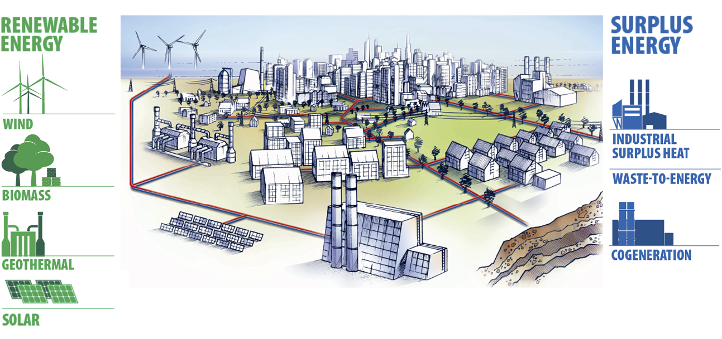
Energy efficient, low Carbon District Heating networks – geared for local renewnables incl. cogeneration plants 高效节能低碳区域能源 – 整合再生资源及热电厂
可再生能源
余能
风能
工业余热
生物质
废弃物能源
地热能
热电联产
太阳能

Slide 8
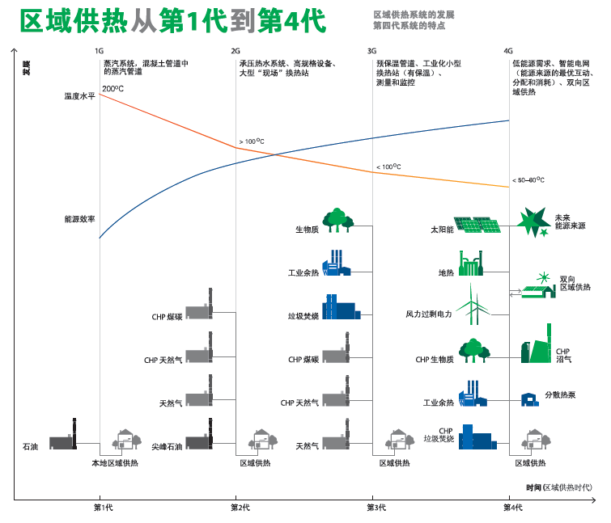
4G District Heating Technology: efficiency gain while adding supply from renewables 4G 区域供热技术：以再生资源提高能效

Slide 9
UN Report – “District Energy in Cities” 联合国报告——“城市区域能源”
Feb. 2015, UNEP and UNHABITAT launched the report of “District Energy in Cities: Unlocking the Potential of Energy Efficiency and Renewable Energy”, which indicated: 2015年2月，联合国环境规划署和人居署联合发布了名为《城市区域能源：充分激发能源效率和可再生能源潜力》的调研报告，并在报告中指出：
A transition to modern district energy systems could contribute to 60 per cent of required energy sector emissions reductions by 2050, and reduce primary energy consumption by up to 50 per cent. 为了将全球气候变暖控制在2摄氏度以内，向现代区域能源系统转型意义重大。这一转型将贡献所需节能量的50%和减少二氧化碳排放量的60%。
45 champion cities on district energy were selected from all over the world. Copenhagen, Sonderborg of Denmark and Anshan, as the only one city of China mainland with support of Danfoss, are in the list. 该报告选取了全球45个区域能源示范城市，其中丹麦哥本哈根、森讷堡市以及中国鞍山市（大陆地区唯一）入围。丹佛斯为这三座城市的区域能源系统贡献了先进理念和解决方案。
The Chinese version has also been published this year. We hope the leaders of cities find the values of district energy and we look forward to seeing more Chinese cities become one of the Champaign cities. 中文版报告也已于今年出版。我们希望城市管理者们能充分意识到区域能源的价值，并期待更多中国城市能成为示范城市。

Slide 10
Content 目录
Global Trends and District Energy
全球能源发展趋势与区域能源
Danish "Energy Fairy Tale" and District Energy
丹麦“能源童话”与区域能源
Danfoss District Energy Applications in China
丹佛斯区域能源在中国的应用

Slide 11
DK: Energy usage stays neutral - even with steady GDP growth 丹麦绿色发展模式
Source: Statistics Denmark , the Danish Energy Agency and DANVA
GDP in real terms
CO₂ emissions
Total water consumption
Gross energy consumption
Since 1980, Denmark has maintained a steady growth in GDP, while the energy consumption index keeps flat, and carbon dioxide emissions has been declining.
从1980年以来，丹麦在GDP保持稳步增长的同时，能耗基本持平，再加上发展新能源取代传统能源，二氧化碳排放量未升反降。

Slide 12
Efficiency of buildings in Denmark 丹麦建筑能效发展
Building energy consumption per sqm decreased 29% from 1980 to 2003 in Denmark, and 53% from 1972.
至2003年丹麦每平米建筑能耗比1980年降低了29%，相比1972年降低了53%.
1st Energy Crisis
第1次能源危机
(1980 = Index 100)
2nd Energy Crisis
第2次能源危机
Source 数据来源: Danish Energy Agency 丹麦能源署
Danfoss contributed in three improvement of the four areas 在能改进建筑能效的四个方面中，丹佛斯业务涉及到了其中三项
Efficiency of central heating systems 提高集中供热系统效率
Metering and Charging 计量收费
Frequency converters control 变频控制
Insulation of doors and windows, roof and wall 提高门窗，屋顶，墙体的保温

Slide 13
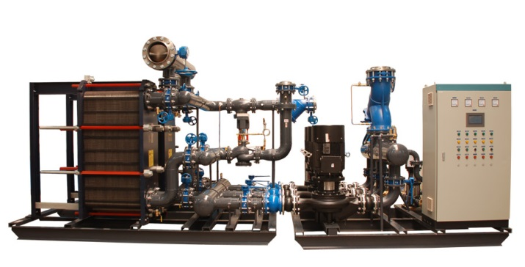
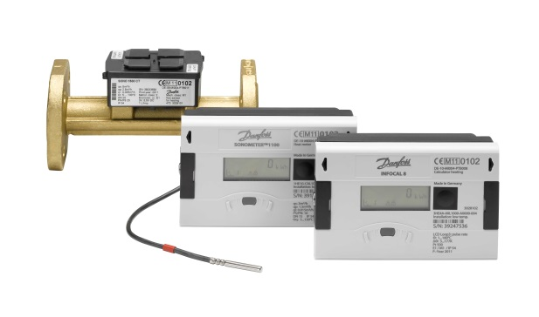
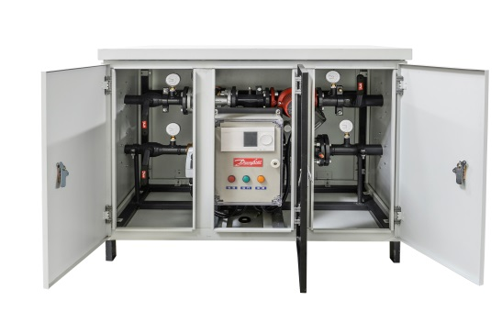
Danfoss China leading in District Energy 丹佛斯与区域能源业务
Danfoss: the largest Danish industrial group and a world leader in providing solutions in the areas of infrastructure, energy, food and climate. 丹佛斯是丹麦最大的工业集团，在基础设施，能源，食品和气候领域解决方案的领导者。
Danfoss Heating Segment 丹佛斯供热事业部
World leader in district energy equipment and solutions是区域能源设备与解决方案领域的世界领导者。
Solutions from heating plant to end user (complete substations, electronic controls, heat meters)可提供从供热设备到最终用户的整体解决方案（完备的换热站、电子控制与热量表）。
Deep application knowhow & broadest product portfolio拥有先进的专有应用技术和广泛的产品组合。
Danfoss China丹佛斯中国公司
Footprint in China for 19 years进入中国市场19年。
Position China as second home market将中国作为第二个家乡市场。
Solution for cold Chain, hot chain, green building and motor efficiency with lower environment impact 可在冷链、热链、绿色建筑和电机效率领域提供环保型解决方案。

Slide 14
Copenhagen District Energy experience as inspiration 哥本哈根的区域能源经验与启发
Anshan stakeholders studied Copenhagen system on site 鞍山的利益相关者现场研究了哥本哈根系统。
Results from Copenhagen DEN system include:
针对哥本哈根DEN系统的研究结果显示：
50% fewer CO2 emissions than with individual heat boilers与独立采暖锅炉相比，二氧化碳排放减少了50%。
Various heat sources connected 连接了各种热源。 → District Heating enabled using more renewable energy 区域供暖利用了更多的可回收能源。

Slide 15
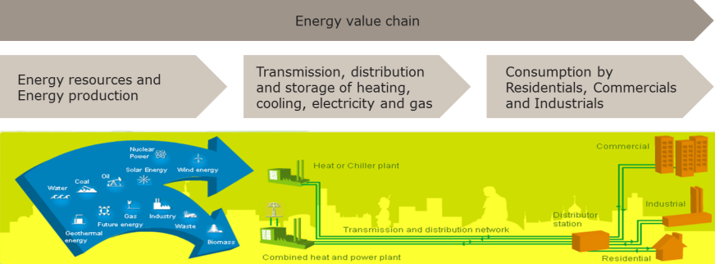
The result of the "Fairy Tale" - Copenhagen 哥本哈根的“能源童话”实践
区域能源一体化设计解决方案
Integrated Energy Solution
混合能源供应，效率高达94% Mixed Energy Recourse with high efficiency as 94%
区域能源系统降低50%二氧化碳排放，降低30%燃料消耗 District Energy achieve 50% CO₂ reduction, and 30% energy production consumption
40%能源生产来自垃圾焚烧，仅有1.8%垃圾需要填埋 Waste incineration produce 40% energy, only 1.8% landfill
Notes:
y

Slide 16
Content 目录
Global Trends and District Energy
全球能源发展趋势与区域能源
Danish "Energy Fairy Tale" and District Energy
丹麦“能源童话”与区域能源
Danfoss District Energy Applications in China
丹佛斯区域能源在中国的应用

Slide 17
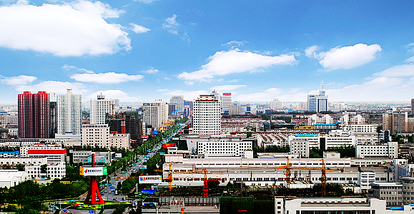
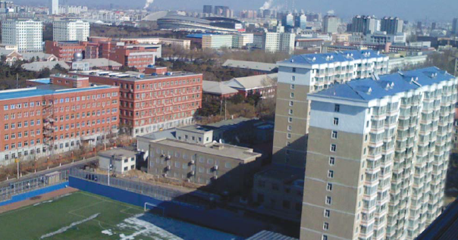
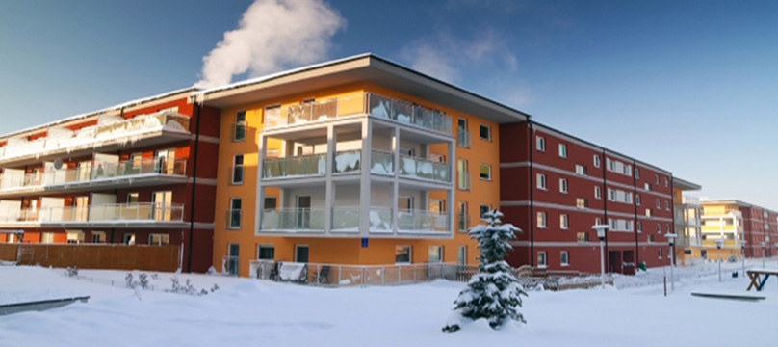
Danfoss District Energy Applications in China 丹佛斯区域能源在中国的应用
Baoding, Hebei
河北保定
Changchun, Jilin
吉林长春
Niujie, Beijing
北京牛街
Benxi, Liaoning
辽宁本溪

Slide 18
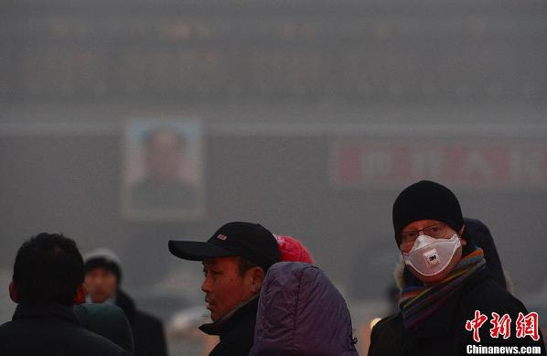
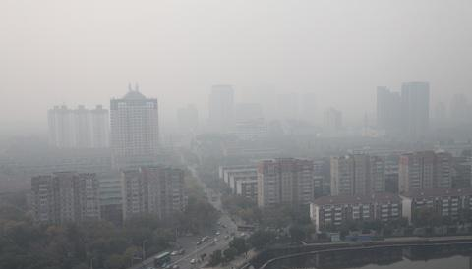
Conclusion and learnings结论与借鉴
Denmark’s deep and proven district energy knowledge also works in China! 丹麦丰富、成熟的区域能源供暖知识同样适用于中国！
Many large cities can consider deploying District Energy to facilitate “Blue Sky” initiatives. 许多大型城市都可考虑实施区域能源项目以推进“蓝天”计划。
Combine quality products and solutions with detailed analysis of current district heating network and additional heat sources. 将高品质产品/方案与针对当前区域供暖网络和其他热源的详细分析进行结合。
Industrial excess heat can be a valuable resource in societies’ fight against pollution. 工业余热是社会与污染作斗争的珍贵资源。
Optimal implementation: Close Cooperation of multiple stakeholders from Government, Industry, District Energy companies and solution providers 最优实施：政府、工业、区域能源企业等多方利益相关者与解决方案提供商密切合作。

Slide 19
谢谢 ！Thank you！

